Slide 1
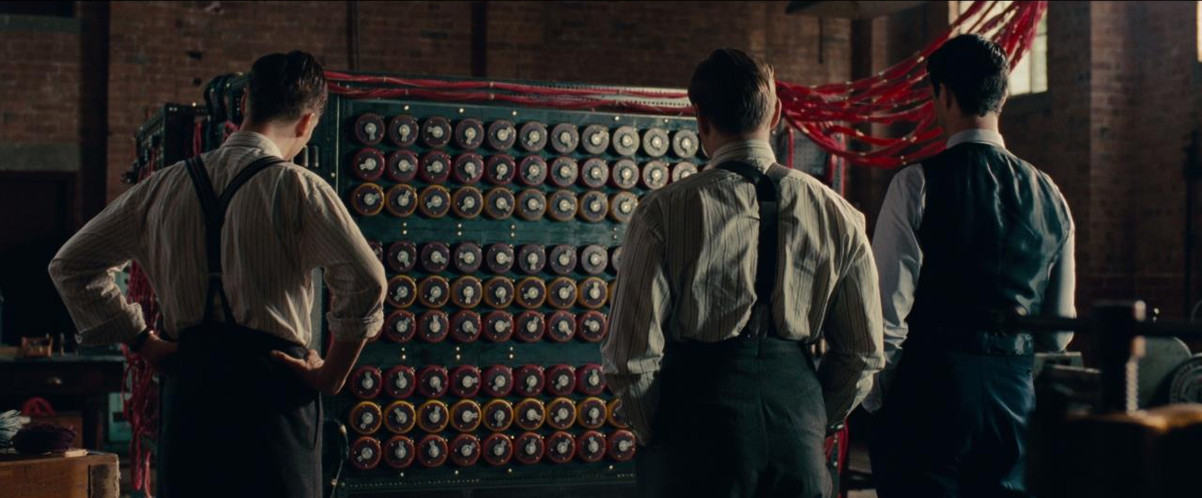
The Imitation Game
COMP 4230
David J Stucki
Fall 2024

Slide 2
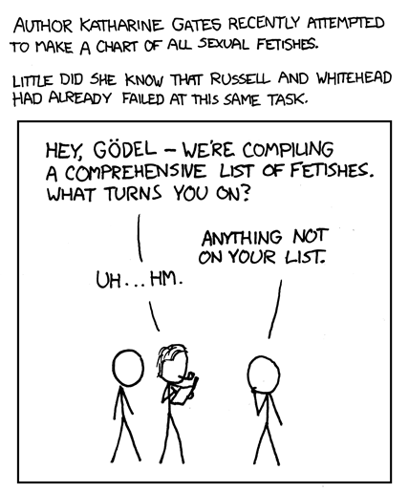
Alerts
Read Chapter 2 of Larson
Read both articles by Douglas Hofstadter on self-reference
Due today:
Essay on AI/ML article with Harry Potter/Penn & Teller analysis
https://xkcd.com/468/

Slide 3
A brief history…
1600s Liebniz speculates about a calculus of thought
1830s Babbage & Lovelace develop ideas around the Analytical Engine
1900 Hilbert's 23 questions
1931 Gödel's first incompleteness theorem
1936 Turing first describes modern computers, including the halting problem
1941 Zuse’s Z3 – 1st electromechanical, programmable, fully automatic, digital computer
1943 Colossus: 1st electronic digital programmable computer
1946 ENIAC: made in the USA by Eckert & Mauchly (w/ von Neumann)
1950 Turing’s Computing Machinery and Intelligence
1954 Turing’s death
1956 Dartmouth Conference: A.I. is born
For thirty years the motivating question driving A.I. research was “Can the Turing Test be passed?

Slide 4
What is the Turing Test?
“I believe that in about fifty years’ time it will be possible to programme computers, with a storage capacity of about 10⁹, to make them play the imitation game so well that an average interrogator will not have more than 70 per cent chance of making the right identification after five minutes of questioning.” —Alan Turing —
Organize into groups of 4
Discuss Turing's 1950 paper. As a group prepare the following:
A 25 words or less synopsis of the Turing Test
Reasons why the TT is a good measure of intelligence
Reasons why the TT is not a good measure of intelligence
Discussion

Slide 5
Early efforts
Eliza: psychotherapist (1966)
Parry: schizophrenic patient (1972)
Racter: randomly generated prose (1984) [start at 10:30, then 21:10]
Jabberwocky (1988)
A.L.I.C.E. (1995)
Cleverbot: Successor to Jabberwocky (1997)
More recently: Siri (2010), Google Assistant (2012), Cortana (2014), Alexa (2014)

Slide 6
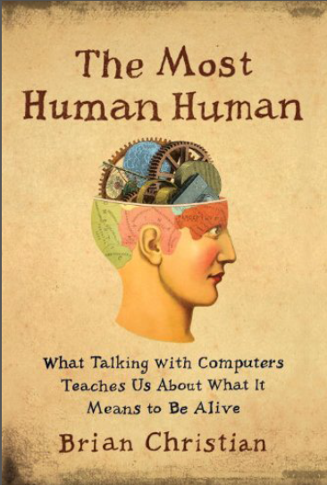
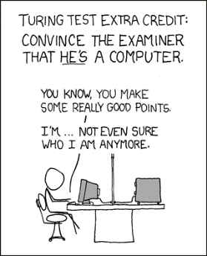
Hugh Loebner & Beyond
Loebner Prize
1991-present
2014: held at Bletchley Park in honor of Turing centenary
Brian Christian participated in 2009 in Brighton, UK
Now part of annual AISB X
In recent years, an increasing dissatisfaction with the TT has led many researchers to seek an alternative
RoboCup RoboCup Overview Bloopers 2024
Winograd Schema Challege Update
Beyond Turing 2015 CACM: Robert French

Slide 7
Next Time…
The Chinese Room

